Slide 1

TEAM MEMBERS :-
Varun ( TEAM LEADER)
Anusha
Sakshi
Reshmanth
Phani

Slide 2

Contents
1. Abstract
2. Introduction
3. Applications
4.. Existing Methodology
5. Drawbacks
6. Proposed Methodology
7. Advantages
8. Architecture
9. Results
10. Conclusion

Slide 3

Abstract
The Bank Account Simulation System is designed to manage customer account details, facilitate secure transactions, and perform automated balance calculations. This project simulates core banking features such as account creation, deposits, withdrawals, and balance inquiries.
By utilizing C programming structures and file handling, this system reduces manual effort, minimizes calculation errors, and provides a persistent record of all financial activities.

Slide 4
Introduction
The Challenge
In many traditional setups, handling customer bank accounts manually is time—consuming and prone to human error. Paper—based ledgers make it difficult to search for records or generate quick reports.
The Solution
To solve this, we developed a Simulation System.
It stores customer details efficiently, calculates interest automatically, and manages transaction history using a computerized interface, ensuring speed and reliability.

Slide 5
Applications
Education
Small Finance
Training
Used in computer science labs to teach students about file handling, data structures, and the logic behind financial software.
Ideal for small cooperative societies or micro—finance groups to track member deposits and loans without expensive software.
A perfect tool for training new bank staff on the fundamental flow of banking operations and transaction processing.

Slide 6

Existing Methodology
Currently, many small—scale systems or older institutions rely on manual methods:
Manual Ledgers: Transactions are written by hand in physical registers.
Passbooks: Updated manually with stamps and
pen.
Spreadsheets: Disjointed Excel files that lack
data integrity and security.
This method relies heavily on human accuracy and physical storage space.

Slide 7
Drawbacks of Existing Method
Human Error
Time Consuming
Security Risks
Manual calculations often lead to mistakes in balance updates, causing financial discrepancies.
Retrieving a customer's history from a stack of physical files takes significant time and effort.
Physical ledgers can be lost, damaged by fire/water, or accessed by unauthorized personnel easily.

Slide 8
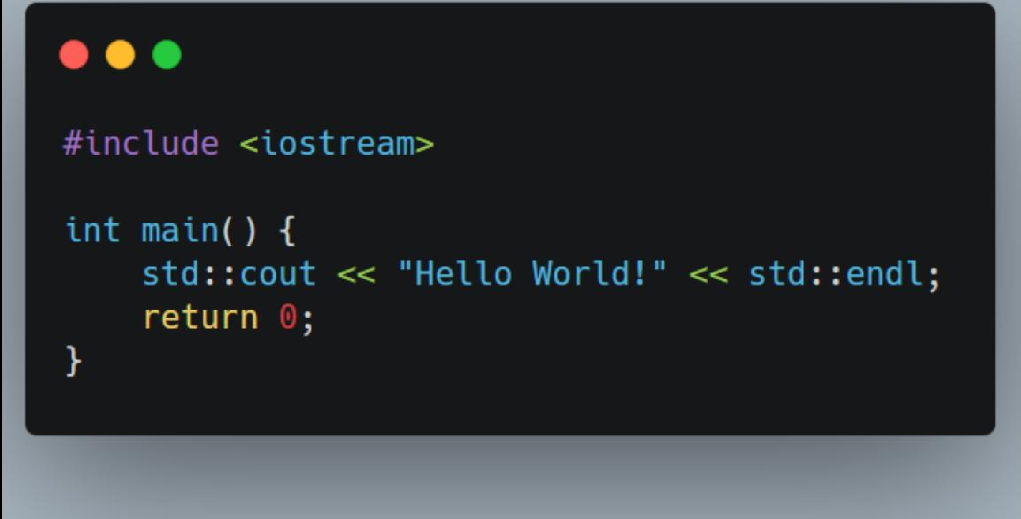
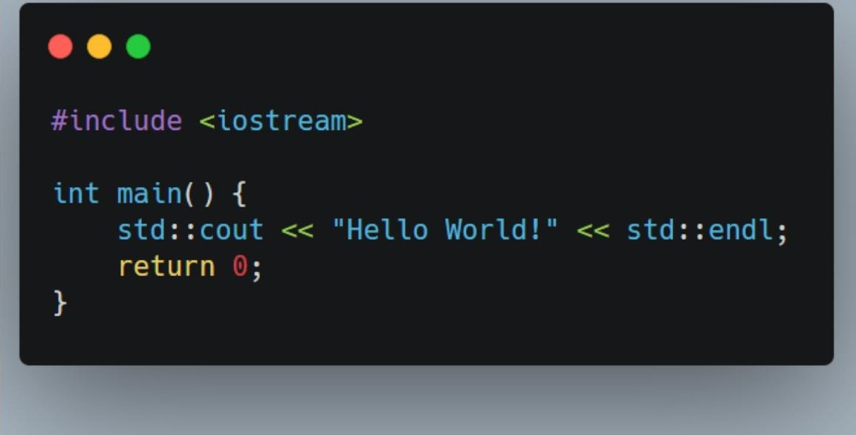

Proposed Methodology
We propose an automated Bank Account Simulation using C Programming. The system utilizes:
Structures (struct): To group employee/customer details like Name, ID, and Balance into a single unit.
File Handling: To permanently save transaction records (writing to .dat or . tKt files) sO data persists after the program closes.
.„, Modular Functions: Separate functions for deposIt(), u1thdrau(), and display() to ensure clean code architecture.

Slide 9
Advantages
Fast Processing
Accuracy
Data Persistence
Instant balance updates and retrieval of customer information with a single keystroke.
Eliminates calculation errors by performing all arithmetic operations programmatically.
Uses file systems to securely store records, ensuring data is never lost when the system is turned off.

Slide 10
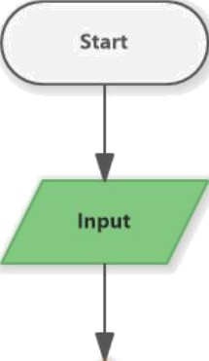
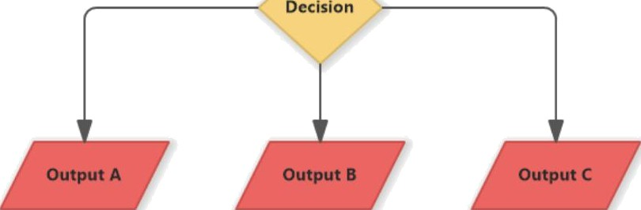
System Architecture
Step 1: Input. The system accepts user credentials and transaction choice (Deposit/Withdraw).
Step 2: Processing. The core logic validates the PIN, checks sufficient balance, and calculates the new total.
Step 3: Storage. The updated record is written back to the file system using file pointers.
Step 4: Output. A success message and the updated balance are displayed on the console.

Slide 11
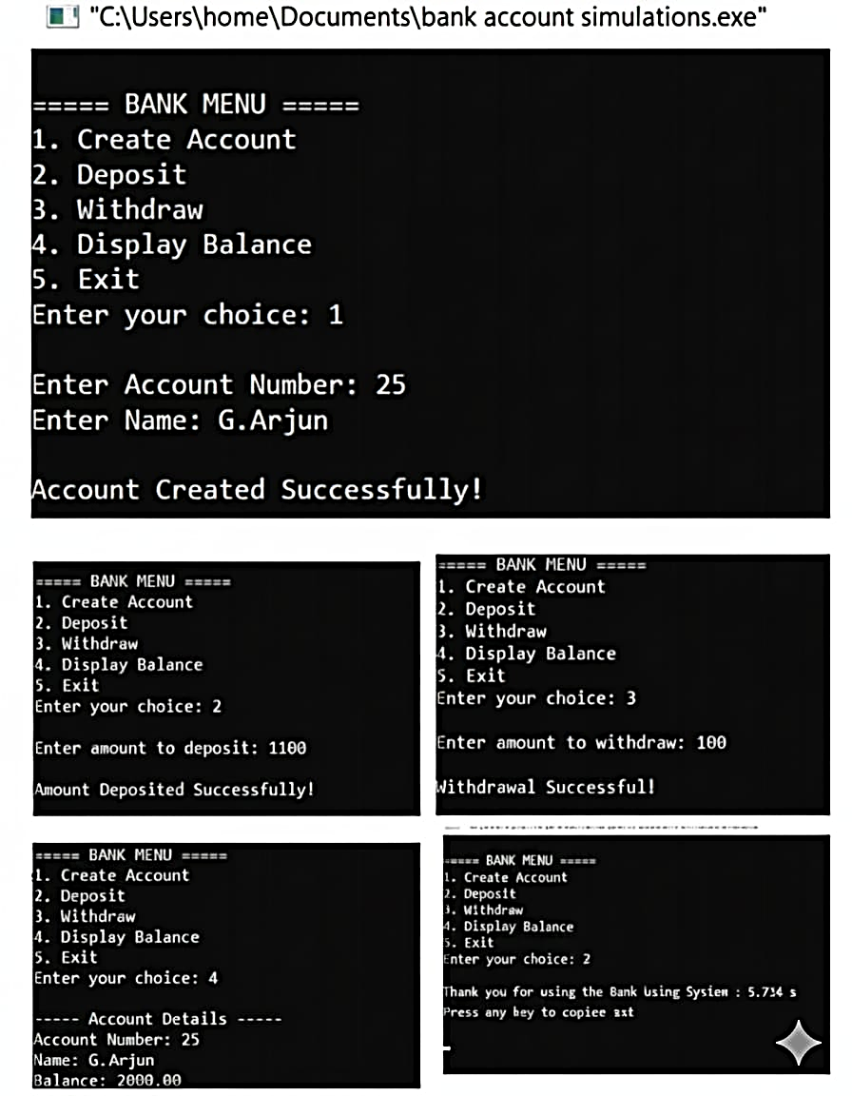
Simulation Results
The screenshot demonstrates the Console Interface of the simulation.
The user successfully logs in.
They select “Deposit" from the main menu.
The system prompts for the amount.
The updated balance is displayed immediately.
This validates the core logic of the proposed methodology.

Slide 12

Conclusion
Our Bank Account Simulation offers a simple yet efficient solution for managing financial data. It saves time, improves accuracy, and provides a robust learning platform for understanding software development in banking. This project successfully demonstrates how programming can solve real—world manual processing problems.

Slide 13
Any Queries?
Thank You!

